Slide 1

Influence of East Asia transboundary outflow O₃
Thresholds of East Asia (EA) outflow: O₃ ≥ 60 ppb
  Days while EA affects whole Taiwan: 60%, prevailing in fall and winter (Sep-Jan)
  Days while EA affects local areas of Taiwan: 40%
If we lower the thresholds of EA outflows to 40 ppb:
  Days while EA affects whole Taiwan: 85%
(Chen et al., 2021)
(a) EA O₃ ≥ 60 ppb affects whole island
(b) EA O₃ ≥ 60 ppb affects
local areas
(c) EA O₃ ≥ 40 ppb affects whole island
Notes:
東亞出流O₃影響臺灣佔比
設定O₃東亞出流事件標準：O₃ ≥ 60 ppb
(a) 影響臺灣日數：60%，好發季節為秋、冬(9月-隔年1月)
(b) 微弱影響日數：40%
設定O₃東亞出流事件標準：O₃ ≥ 40 ppb(東亞背景值)：
(c) 影響臺灣日數：85%

Slide 2

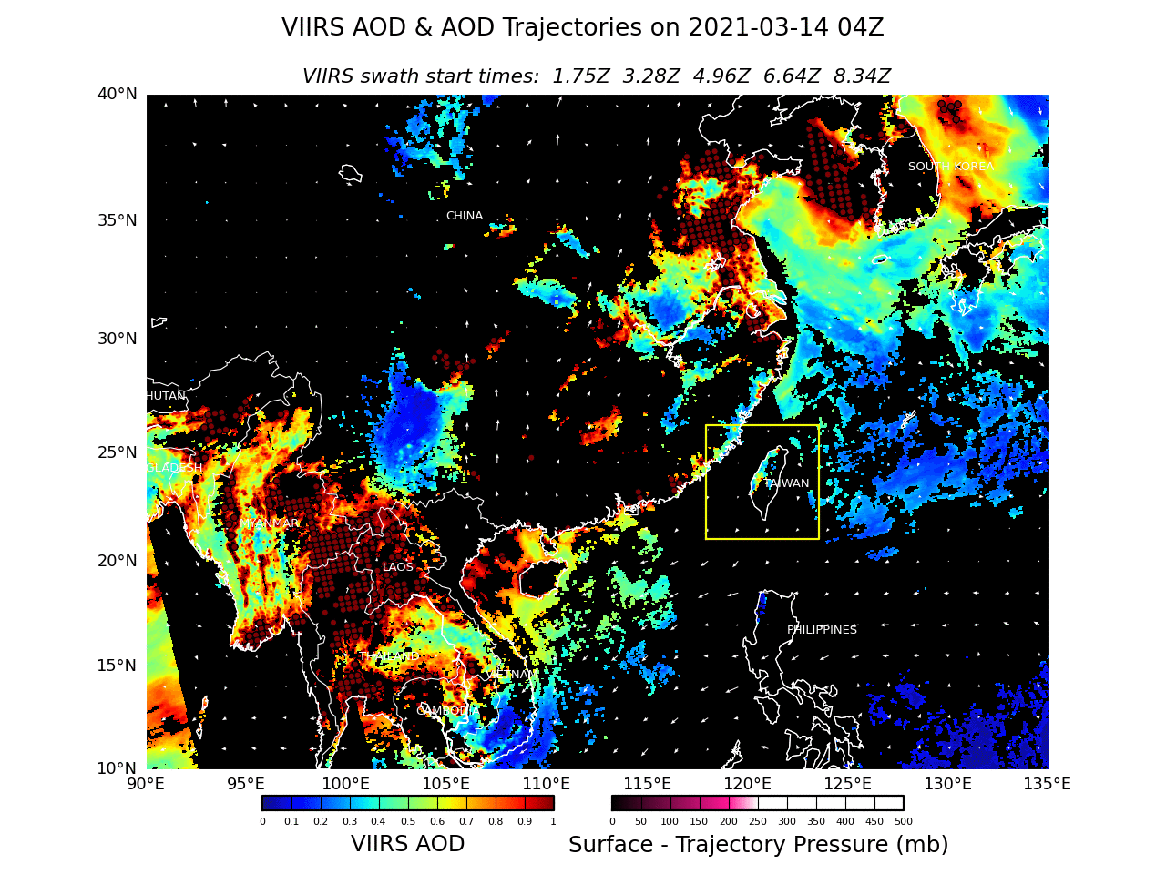

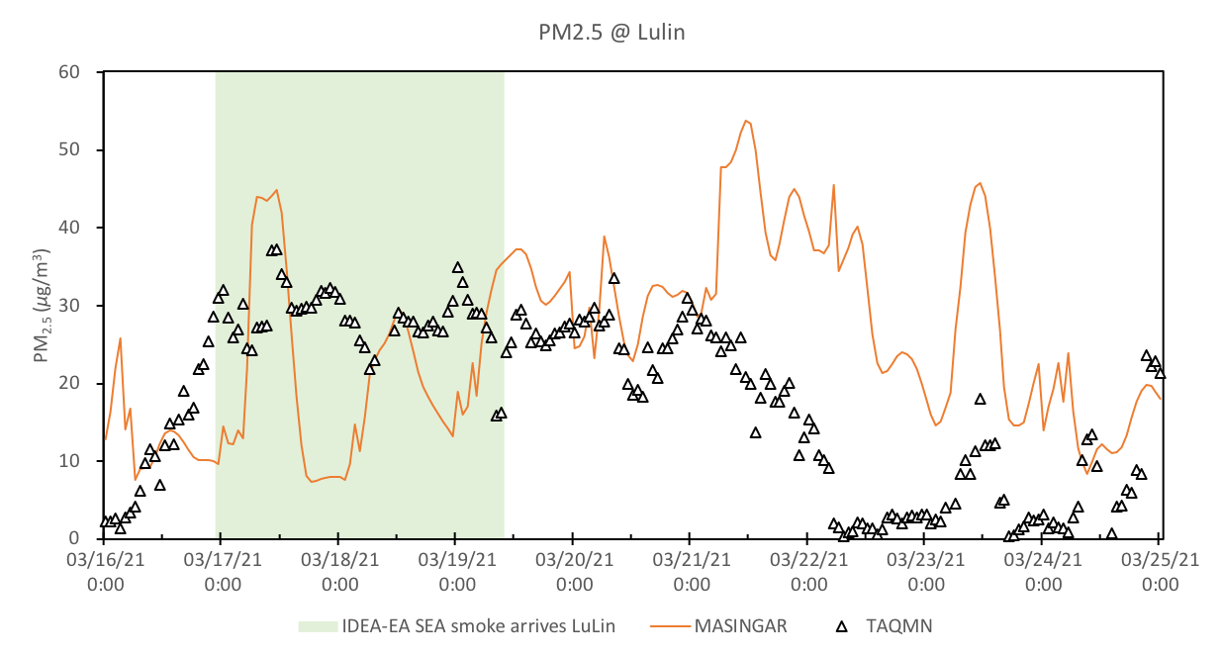
Infusing satellite data into aerosol forecast for near real-time episode detection and diagnosis in East AsiaIDEA-EA
東亞衛星反演預報系統建置 (Chen et al., 2023)
An aerosol trajectory diagnostic approach (IDEA-EA) by infusing real-time satellite AOD data into the method is demonstrated to achieve two objectives:
  to forecast aerosol trajectories arriving at the target region;
  to back trace the source areas from the target region.
A smoke in Southeastern Asia (SEA) in late March, 2021 is demoed by (a) IDEA-EA forward trajectories, as well as (b) time series of PM_{2.5} observations and MASINGAR model simulations at Lulin site.
(a)
(b)

